Slide 1
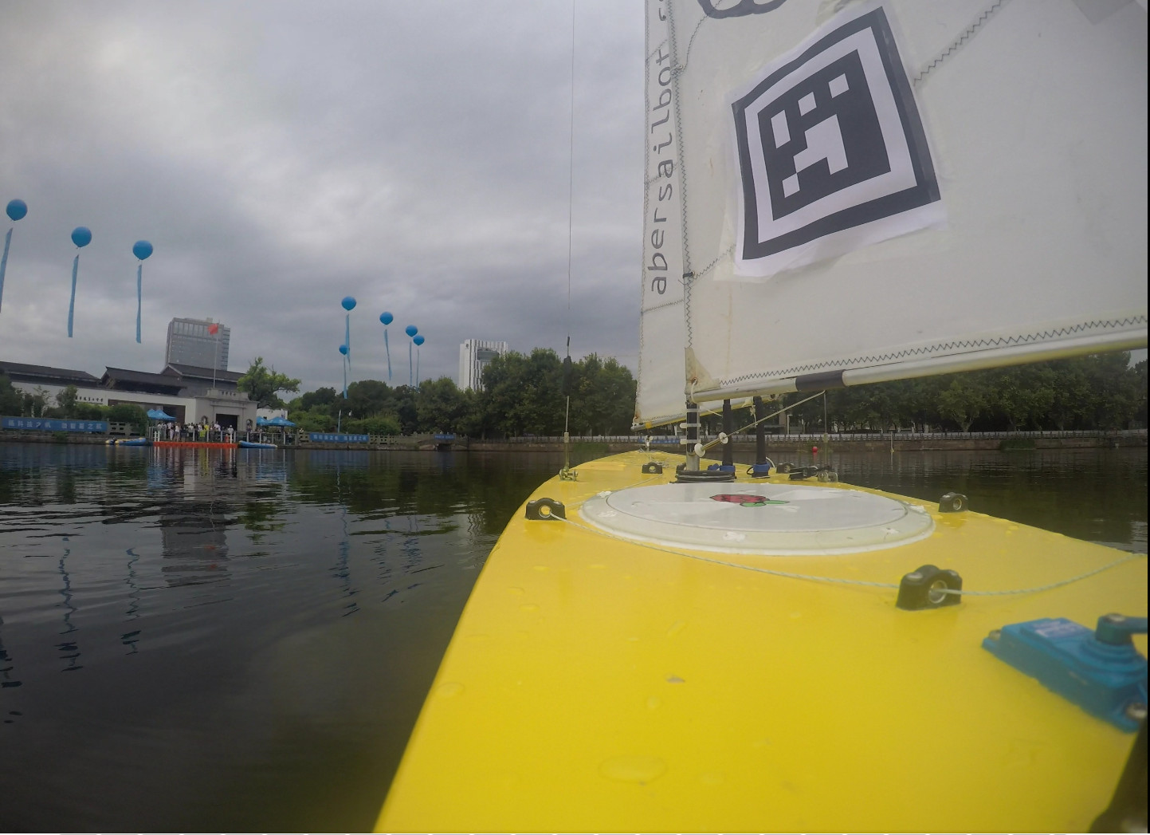

Notes:
---Lizzie---
Introduction

Slide 2
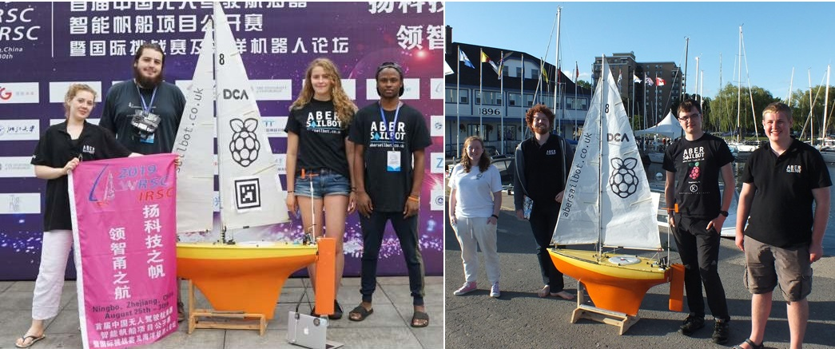



The Team
fb.com/abersailbot @abersailbot sailbot@aber.ac.uk
Notes:
We are AberSailbot!
Student led
Few members
Want more to join

Slide 3
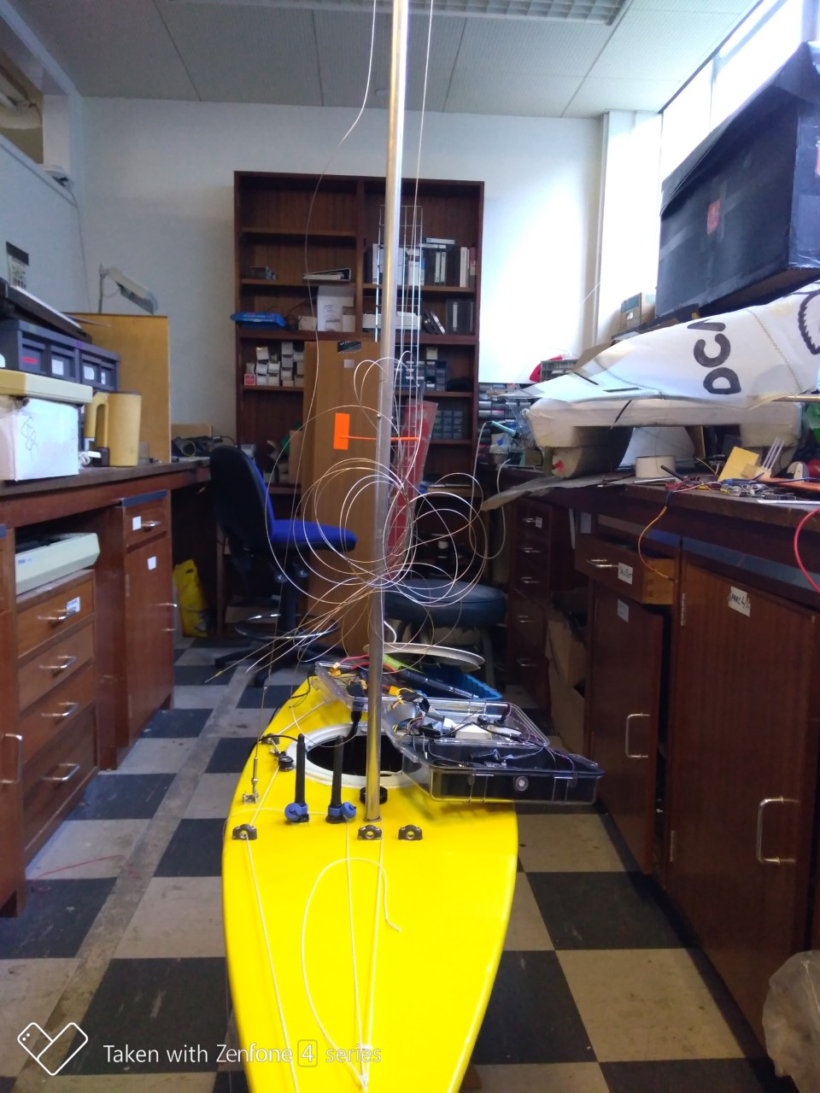
What do we do?
Build Autonomous Robotic Sailing Boats
Write code
Solve the ton of issues that come with
Compete
Have fun
fb.com/abersailbot @abersailbot sailbot@aber.ac.uk
Notes:
Robotic Boats
RC and Sail Themselves
Code (boatd etc)
Competitions
Microtransat
Not alone - community of people

Slide 4
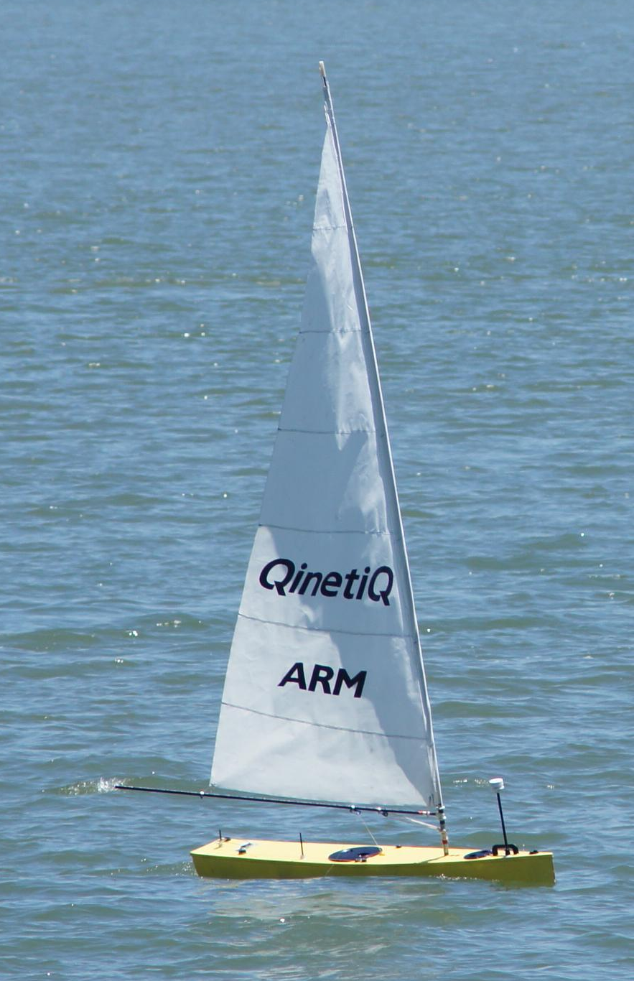
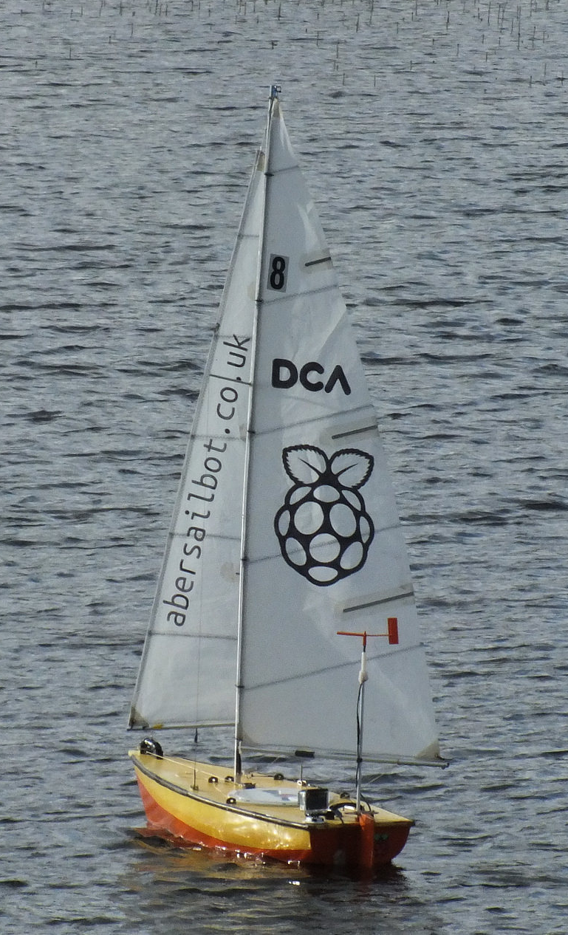
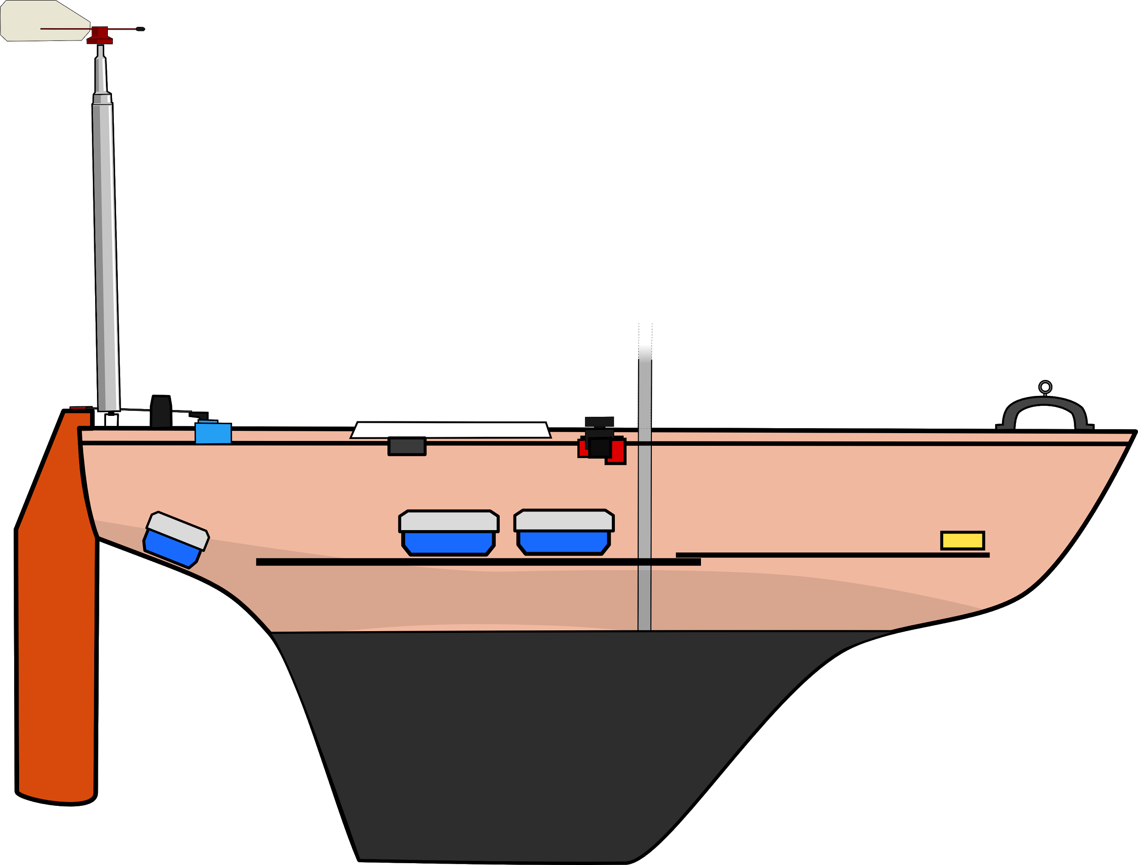
The Boats
Dewi’r Ddraig
Kitty
fb.com/abersailbot @abersailbot sailbot@aber.ac.uk
Notes:
Dewi’r Ddraig
Facts
Main and Jib
Maxi-MOOP hull - Paul Miller
1.2M, not the fastest, strong wind
Stable & reliable
New
Wind Sensor - dept design (rotary encoder)
Handle
Storm Sails
Electronics…
We have a simulator...
Kitty
Still work to be done
Needs new sail
Boat much larger
Detachable keel

Slide 5
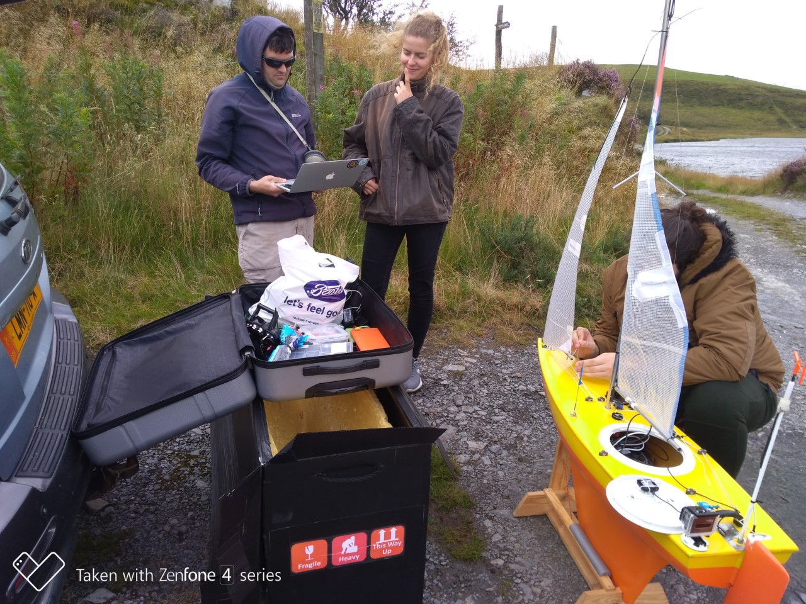
Plan for this year
Build Laser Sailing Boats in team (plus a racing event)
Build a fully new boat (Dewi’s young sister)
Write new behaviour and fix the exiting ones
RoboBoat in Finland
WRSC
fb.com/abersailbot @abersailbot sailbot@aber.ac.uk
Notes:
Robotic Boats
RC and Sail Themselves
Code (boatd etc)
Competitions
Microtransat
Not alone - community of people

Slide 6
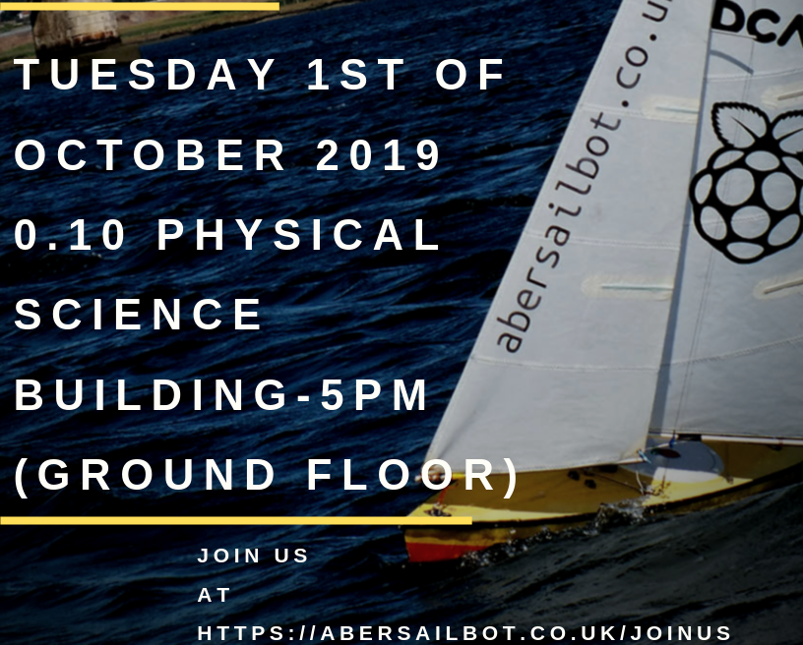
First Meeting
Notes:
Robotic Boats
RC and Sail Themselves
Code (boatd etc)
Competitions
Microtransat
Not alone - community of people

Slide 7
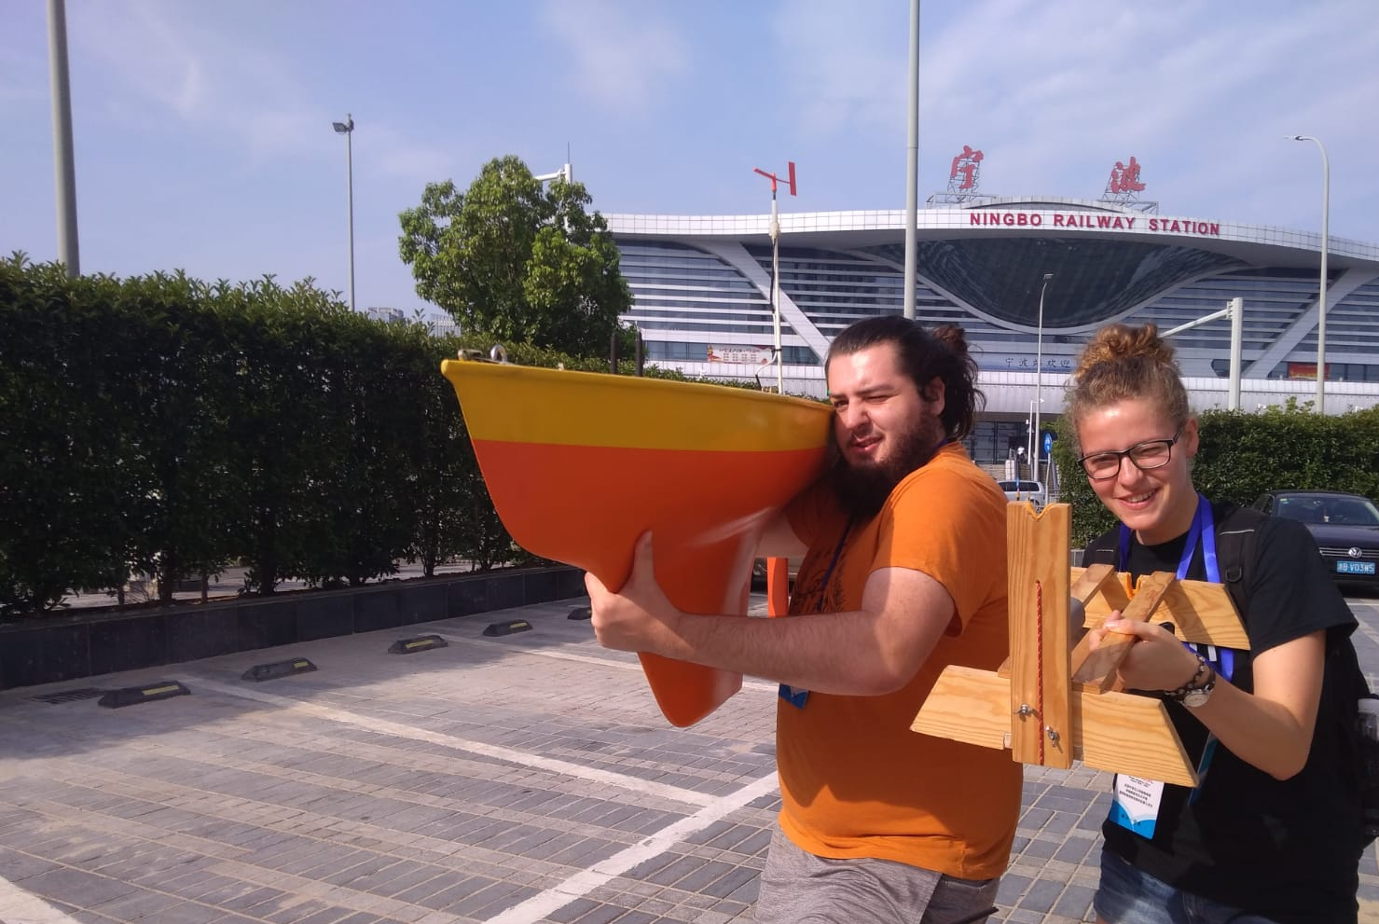
Thanks for Listening!
JOIN US!
abersailbot.co.uk/joinus
fb.com/abersailbot @abersailbot sailbot@aber.ac.uk
Notes:
Fill form (abersailbot.co.uk/joinus)
Give us email in ThinkTank
Facebook Message, Tweet, Email

